Slide 1
What’s new for developers in Windows 10 Version 1511 Developer’s Guide to Windows 10 Build 10586 SDK Update
Andy Wigley
andy.wigley@microsoft.com
@andy_wigley
Shen Chauhan
shen.chauhan@microsoft.com
@shenchauhan

Slide 2
Agenda
Windows 10 Version 1511
Continuum for phone
Microsoft Passport and Windows Hello
Universal Windows Platform 10586 SDK
Visual Studio 2015 Update 1
Getting the developer tools

Slide 3
Windows 10 Version 1511

Slide 4
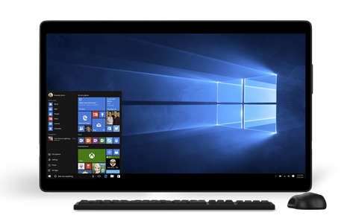
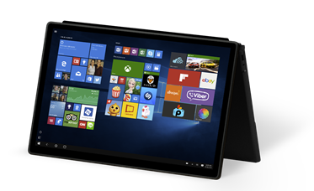
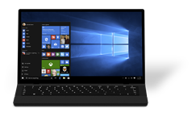


Momentum for Windows 10 since release
29 July 2015
Version 10.0 Build 10240
1.25 billion Windows Store visits
2x engagement on the Windows Store*
110 million Windows 10 devices
4x dev revenue per Windows 10 device*
* Compared to Windows 8.1
Notes:
On July 29, 2015 Windows 10 was made generally available for desktops, laptops and tablets, as well as IoT devices, such as the Raspberry Pi 2. In the few months since Windows 10 launched, we’ve seen great adoption and engagement of Windows 10 and the Windows Store. Since launch, we’ve seen over 1.25 billion Windows Store visits from over 110 million devices. Engagement on the Windows Store is up 2x compared to Windows 8.1, which resulted in 4x revenue for developers.

Slide 5
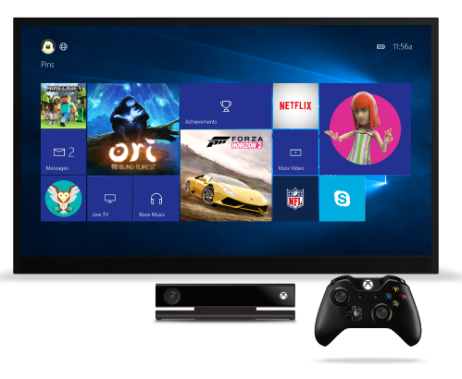
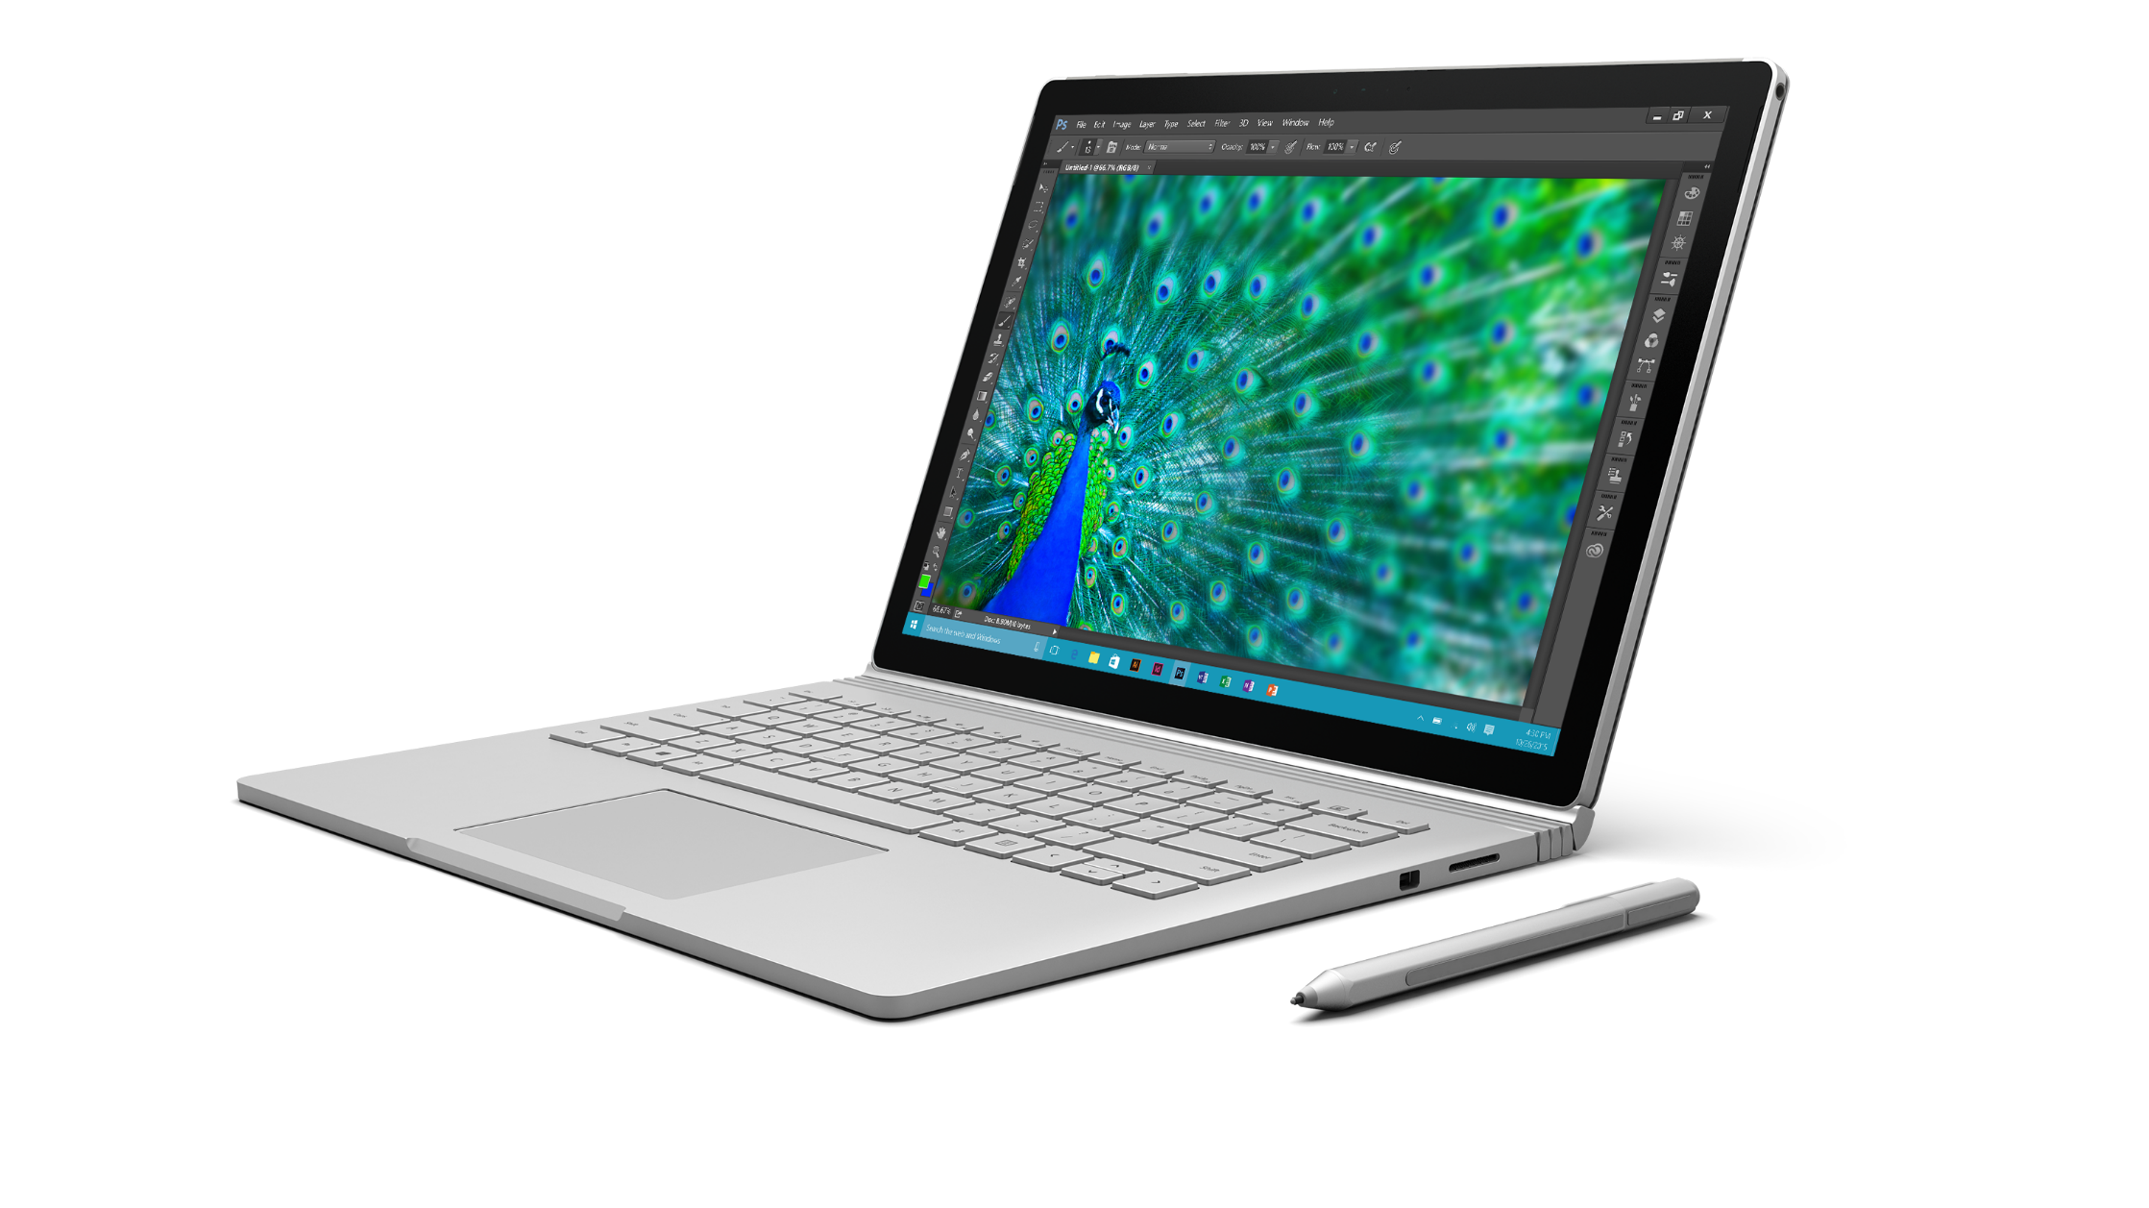
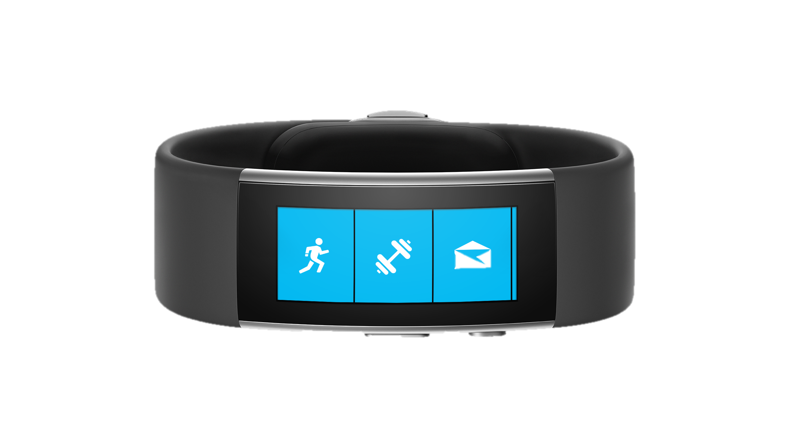
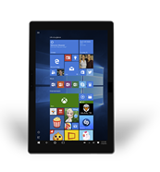
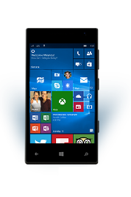
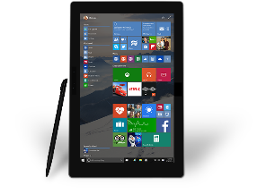
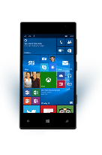

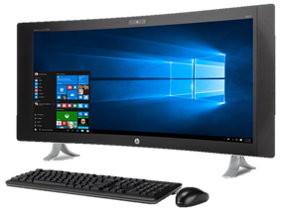
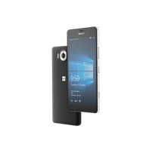
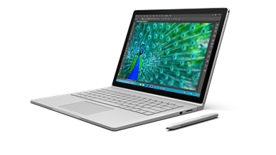
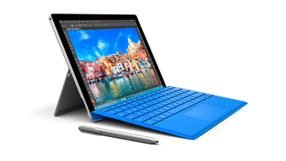
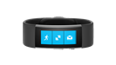

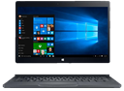

Version 1511: Bringing our device family together
29 July 2015
Holiday 2015
Version 10.0 Build 10240
Version 1511 Build 10586
Notes:
In the holiday 2015 timeframe, we’re bringing Windows 10 to phones with Windows 10 Mobile, as well as Xbox One with the New Xbox One Experience. There’s also a great lineup of new hardware available, ranging from our own Microsoft Band 2, new Lumia 950 and 950 XL phones, to Surface Pro 4 and Surface Book, alongside great hardware from our OEM partners.

Slide 6
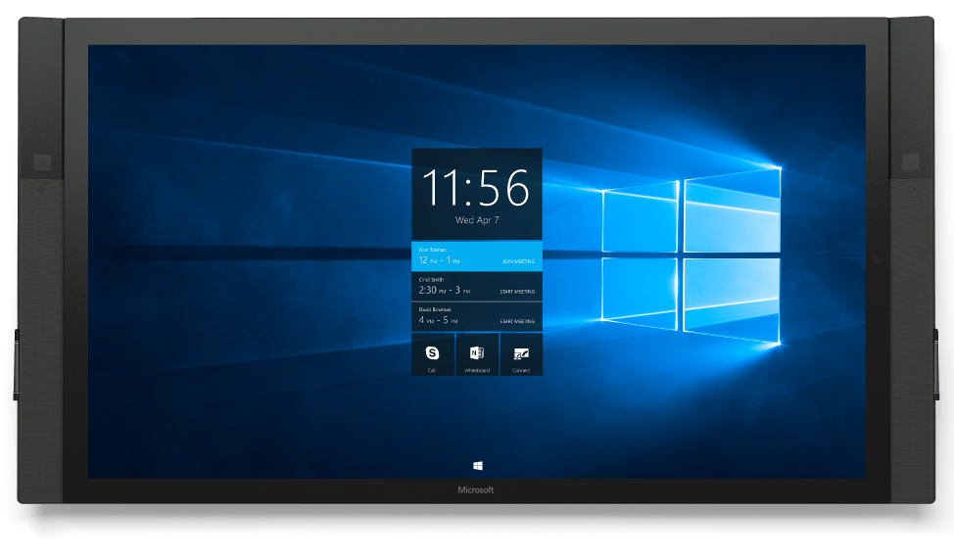
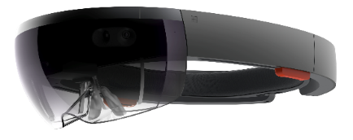
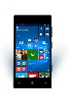
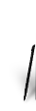
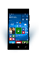
2016: Bringing our device family together
29 July 2015
Holiday 2015
Early 2016
Notes:
And we’ll continue to bring our device family together early 2016 with new experiences across Microsoft HoloLens and Surface Hub.

Slide 7
Key Features in Windows 10 version 1511
Bringing Windows 10 to Phone devices
Display on a second screen with Continuum for phone – supported on Lumia 950, 950 XL
Microsoft Passport and Windows Hello
More secure authentication without passwords
Login using biometrics: fingerprint, iris detection, face detection
Windows 10 for Enterprises
Windows Store for Business
Microsoft Passport for Work
Enterprise Client State Roaming
Build 10586 SDK
Build 10586 Developer SDK featuring bug fixes and new and improved APIs

Slide 8
More efficient and flexible appx installation
Reduced Installation Footprint
.Until now, we have required disc space on the device of twice the AppX package size to install an app.
So a 1GB app package would require 2+GB of disk to complete the install.
Now we require only a small amount of incremental space, so a 1GB app package would require about 1.1GB on disk.
Secondary drives on desktop
On desktop secondary drives are now supported for app installs so you can install apps to D: by changing the location in settings under storage.
On mobile, the storage setting similarly allows apps to be installed on a SD card if one is present

Slide 9
Continuum

Slide 10
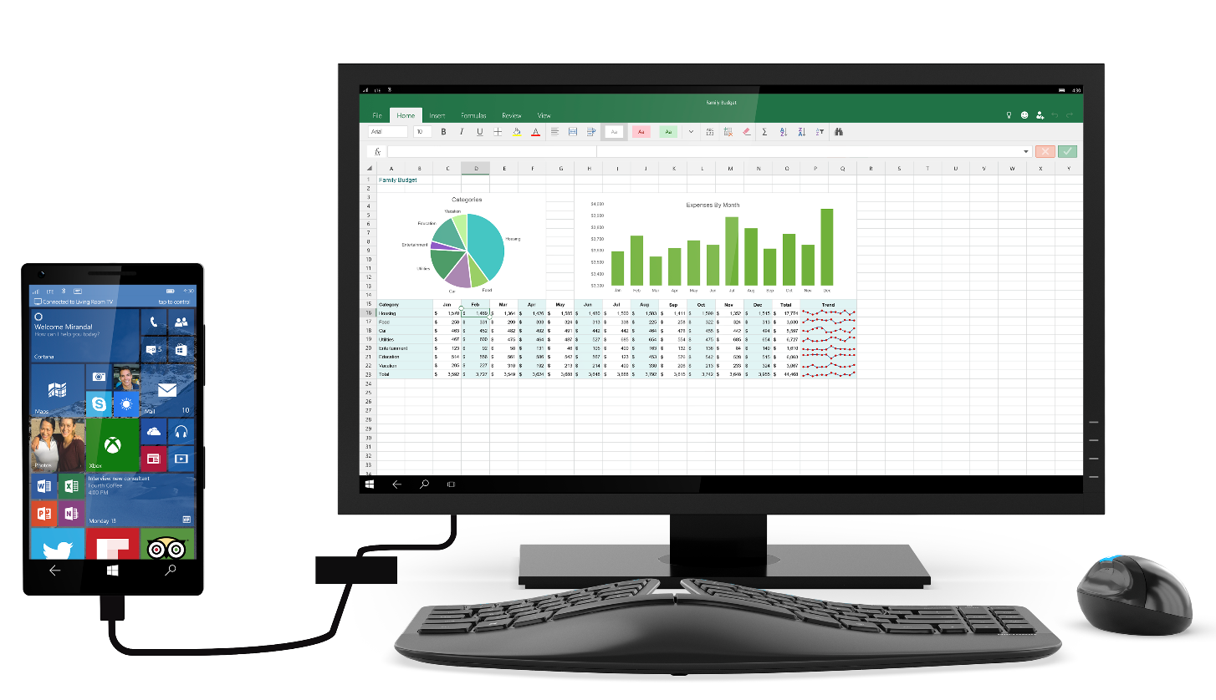
Continuum
Continuum designed to deliver the mobility of the experience
Continuum for 2-in-1 delivering tablets that can replace your laptop
*New* Continuum for phone – where any screen becomes your PC

Slide 11
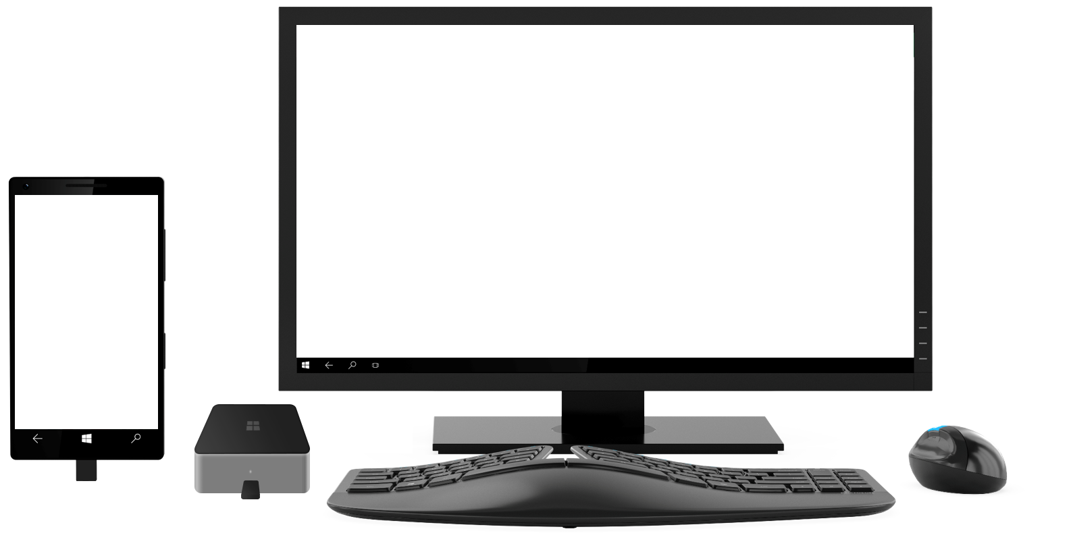
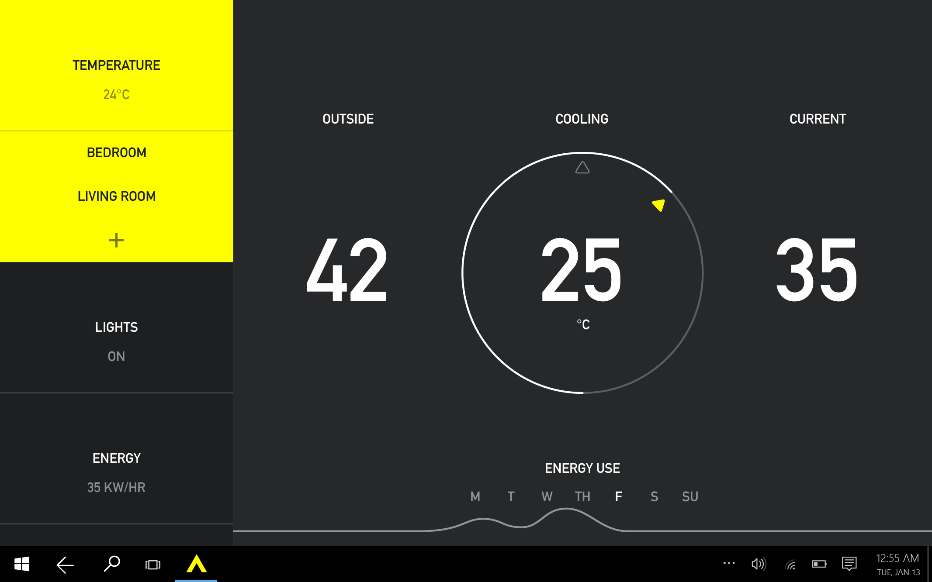
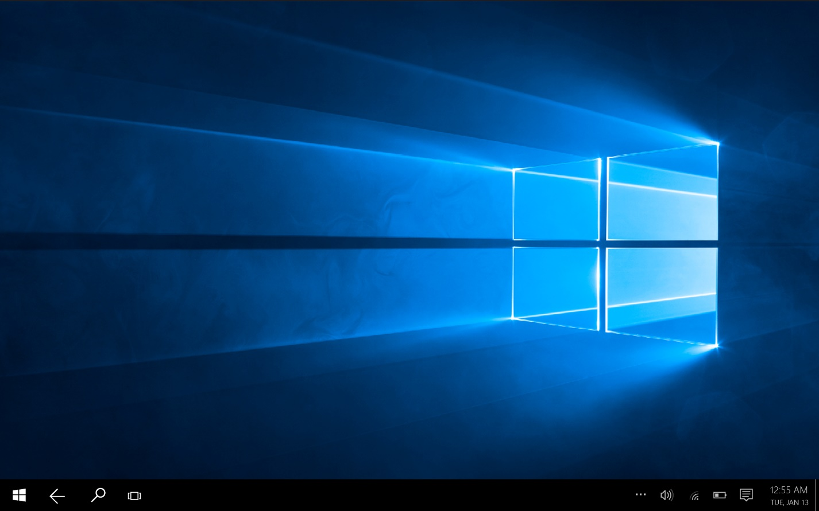
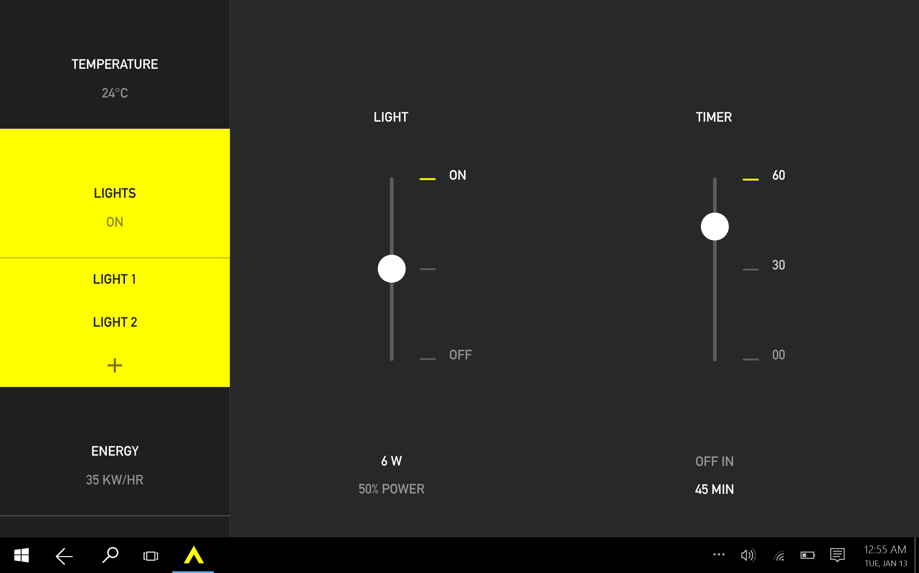
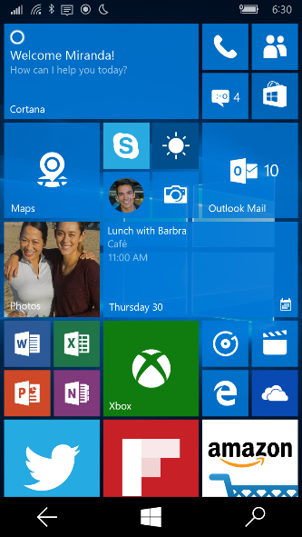
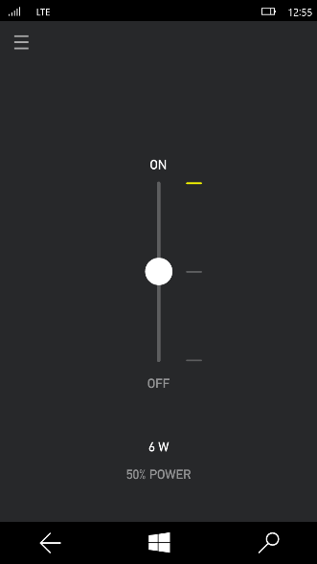
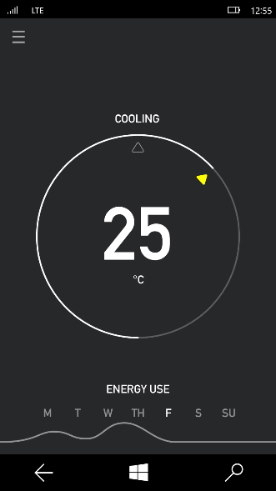
Continuum on Windows
Notes:
Another way adaptive apps can be used on Windows 10 is with a feature we call Windows Continuum. You may already be familiar with Continuum on 2-in-1 devices like the Microsoft Surface, where Windows optimizes its user experience to touch input without the keyboard attached and the more traditional “desktop” user experience with it attached.
With Continuum for Phones, users can connect either wirelessly or using the wired Microsoft Display Dock (http://www.microsoft.com/en-us/mobile/accessory/hd-500/) to their monitor, keyboard and mouse to use the adaptive apps on their phone on the large screen with precise input.
Clickthrough:
<click>
App opens on phone
<click>
App is opened on monitor, allowing phone to be used for other tasks
<click>
User can use app on monitor with keyboard and mouse
<click>
App can be opened back on the phone to continue the mobile experience

Slide 12


Slide 13
How does Continuum affect the app developer?
For UWP, connected screen is just another screen size
Standard adaptive UI techniques apply
Primary Display
5”
8”
13”
Secondary Display
Phone
Viewing Distance: 16.3”
Tablets and 2 in 1
Viewing Distance:
20”
Small and Large Laptops
Viewing Distance:
24.5”
Secondary Display
Small and Large Desktop Monitors
Viewing Distance:
28”
TV
Viewing Distance:
84”

Slide 14
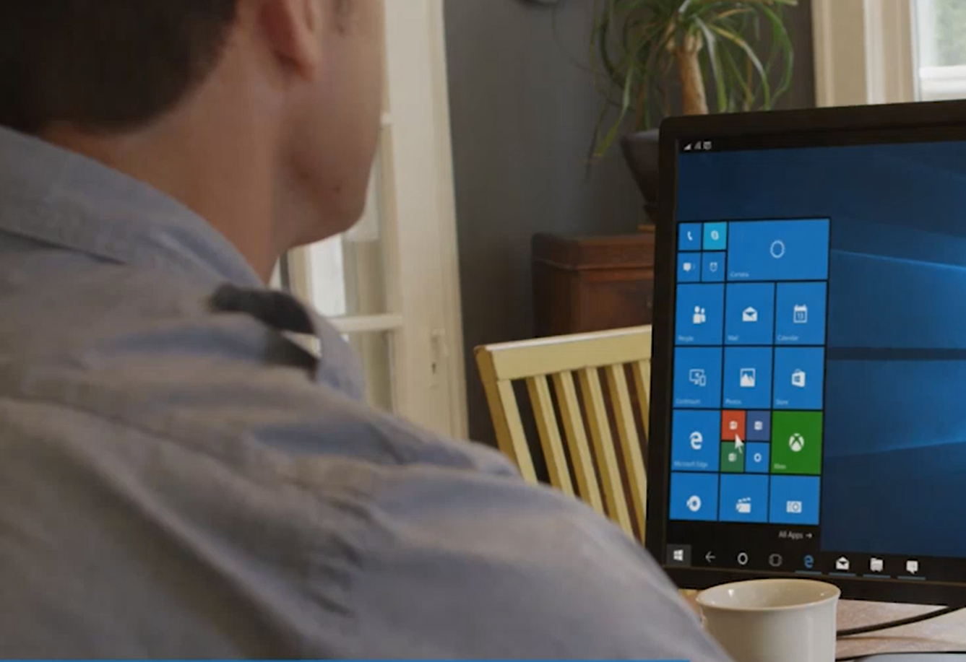
How does Continuum affect the app developer?
Apps that run independently on the connected screen must be UWP apps
Non-UWP apps shown greyed out on connected display Start Screen and Apps menu
Non-UWP apps can display on connected screen when Screen Mirroring selected in Continuum app Display settings
Majority of apps written for Windows Phone 7.x, 8.x can run on Windows 10 Mobile

Slide 15
Demo: Windows 10 Mobile and Continuum

Slide 16
Microsoft Passport and Windows Hello

Slide 17



Looking for you…
Windows Hello
Provide reliable, friction free authentication
Wednesday, December 9, 2015
12
13
Notes:
It starts with login …. Windows knows who you am.
Windows 10 will support Microsoft Passport, which allows you to authenticate your users without a password at all. Windows Hello biometrics unlock Microsoft Passport, for a truly seamless experience that is more secure than today’s world of complicated passwords to provide reliable, friction free authentication with full access to all experiences and commerce.

Slide 18

Hello Andy!
Wednesday, December 9, 2015
12
13
Notes:
From there it can provide me personalized, experiences and recommendations for me.

Slide 19
Windows Hello: Sensor Support
Fingerprint
All current fingerprint capable devices are supported
Face
All current (f200) and future Intel® RealSense™ are supported for Windows Hello face authentication
Kinect for Windows V2 (In Beta 15/12)
All devices that include an IR sensor that meets Microsoft sensor spec
Iris
A selection of devices will be arriving to market within the next 12 months
More details on sensor requirements and support coming soon

Slide 20
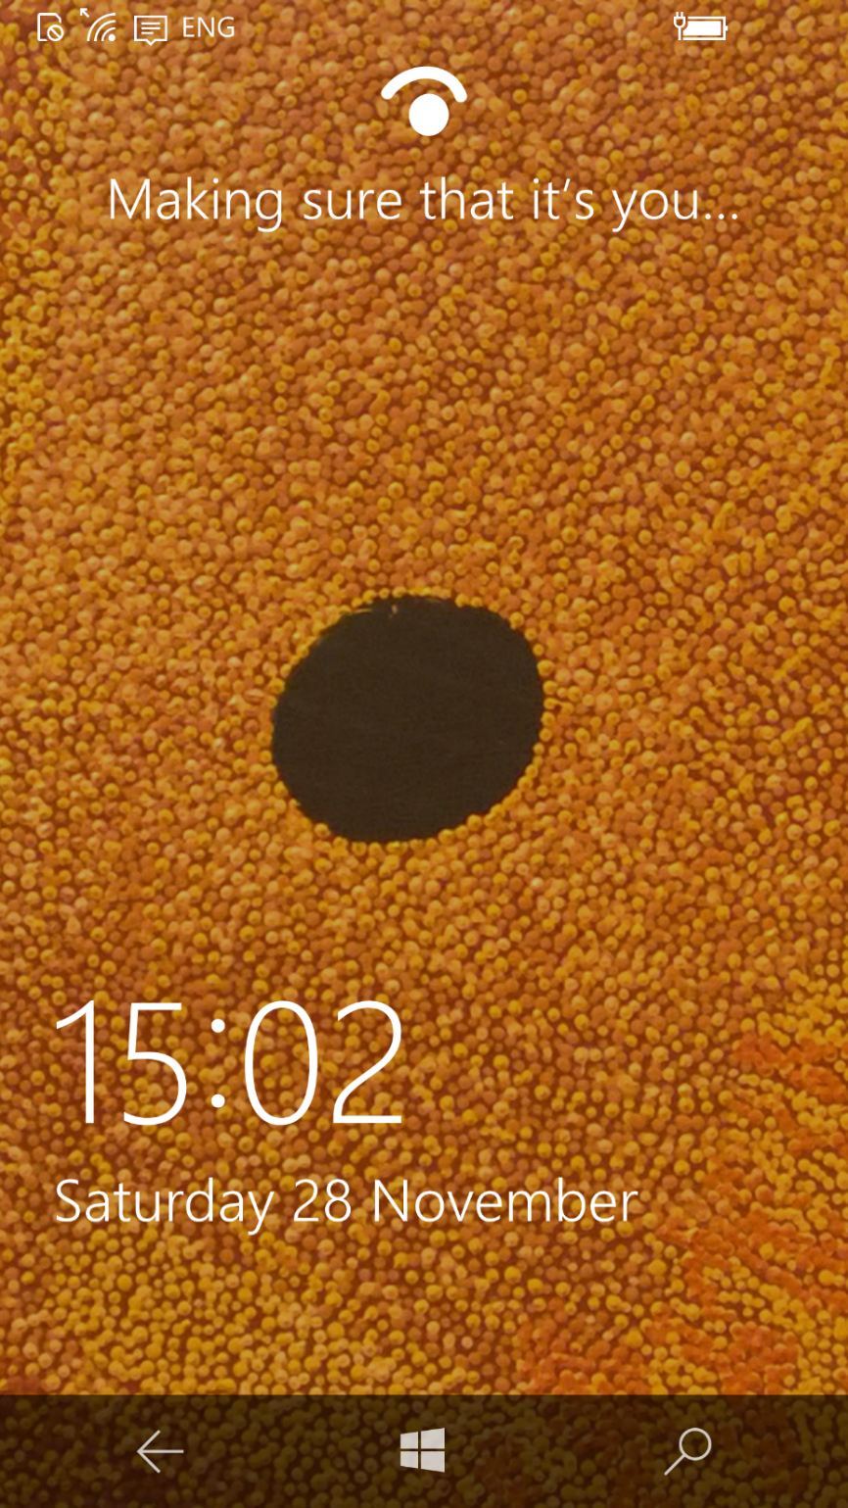

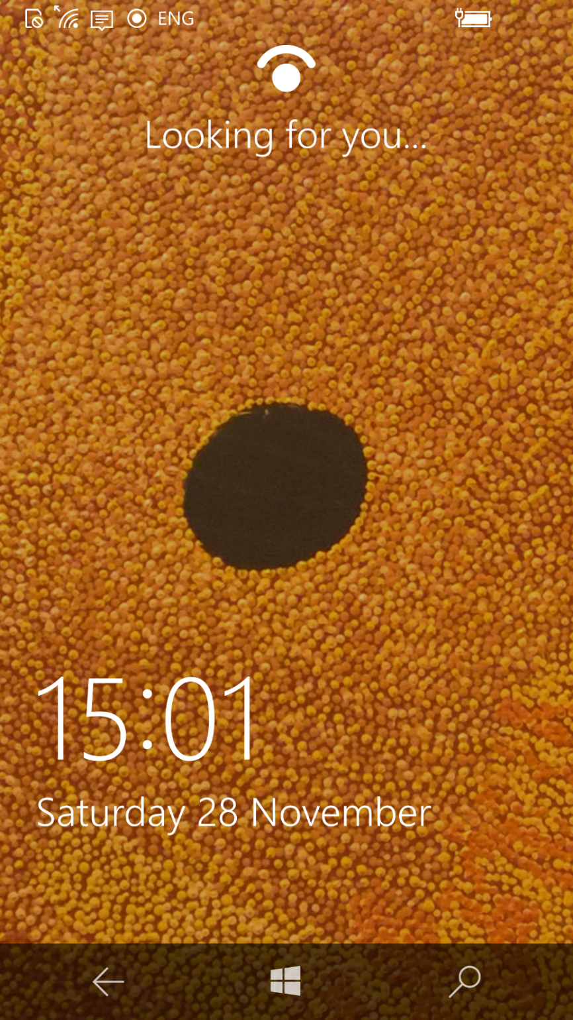
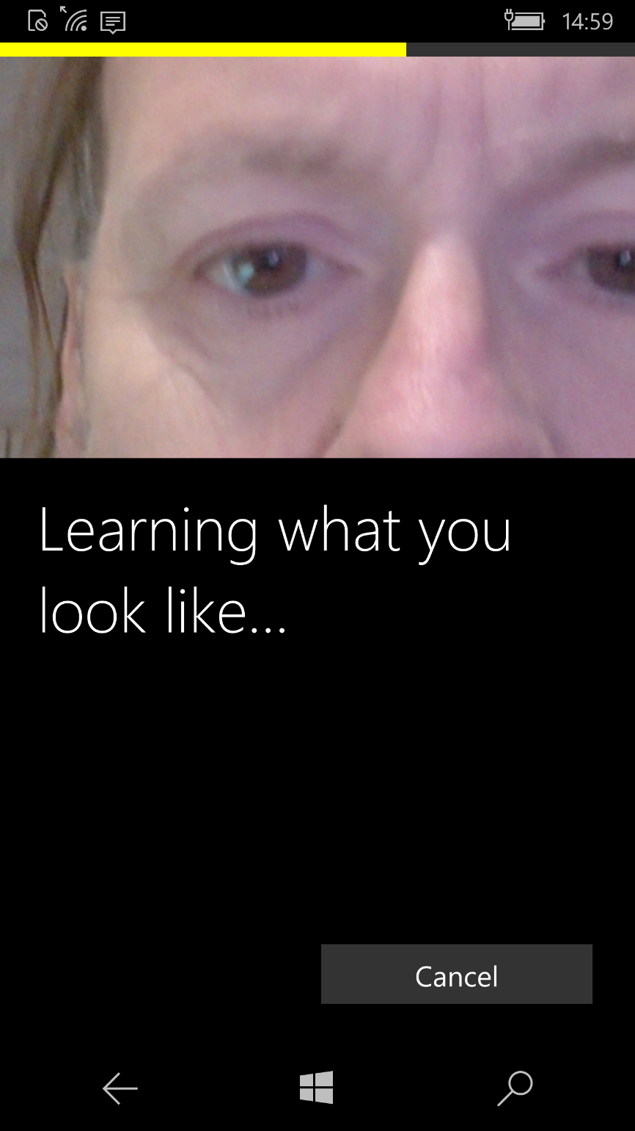
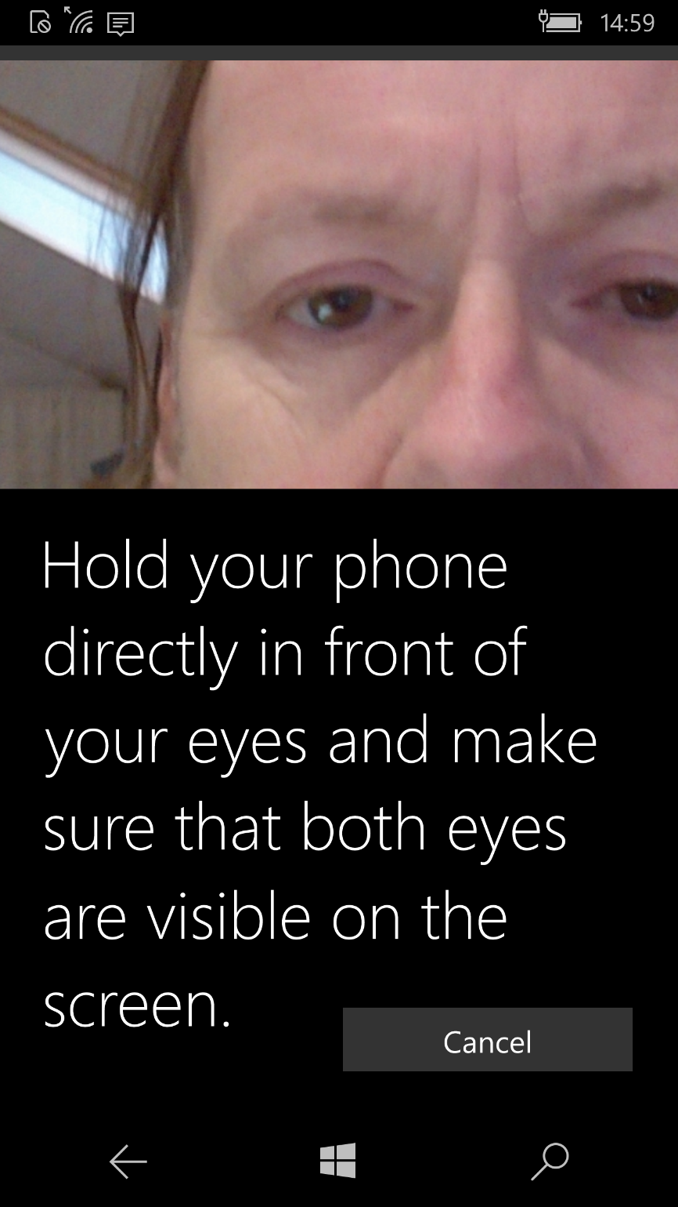
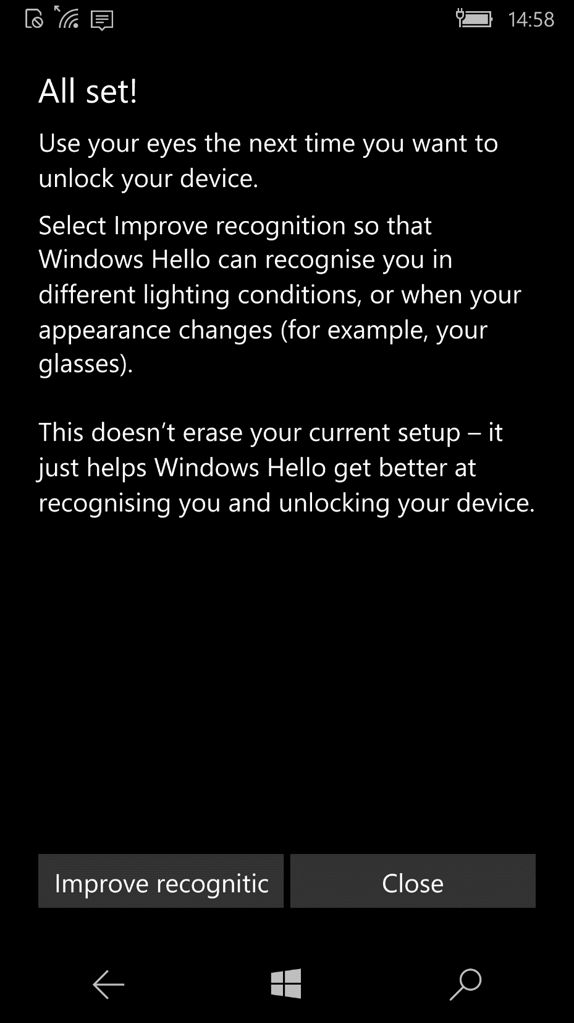
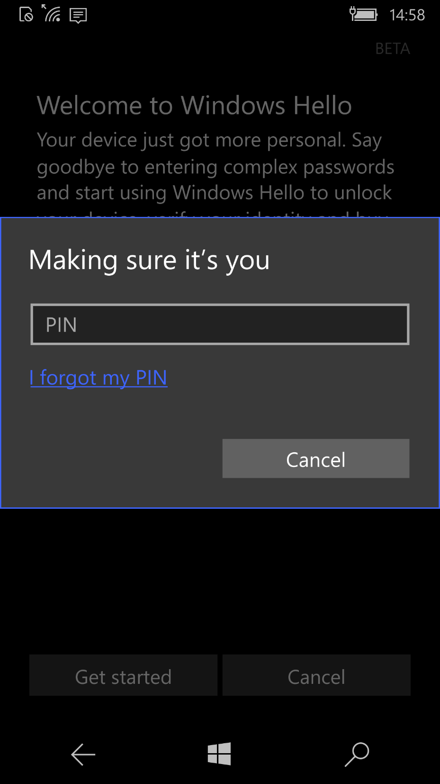
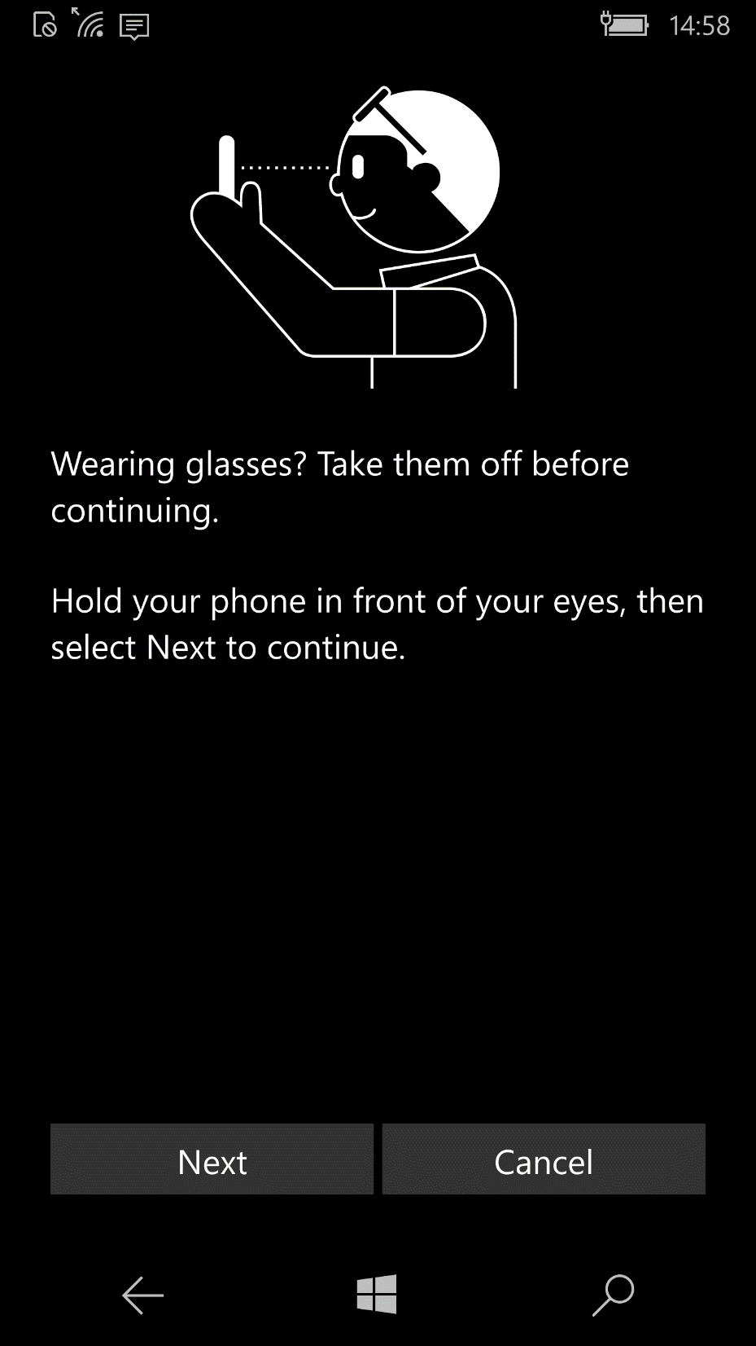
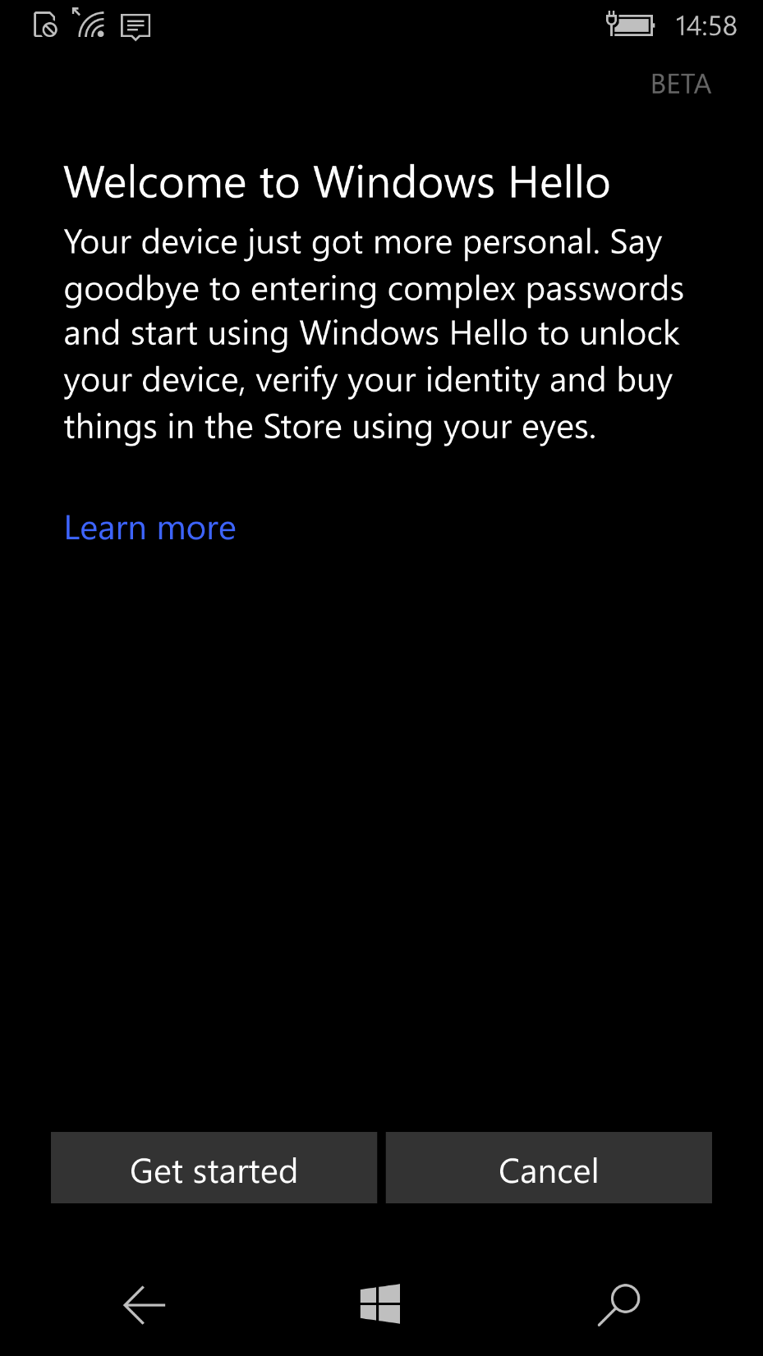
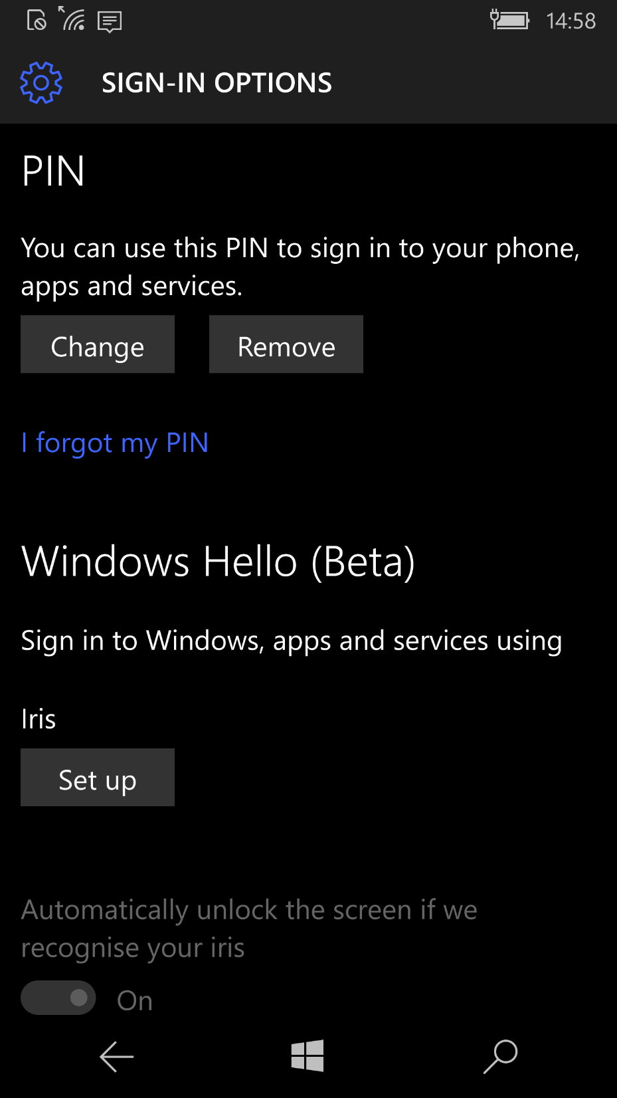

Slide 21
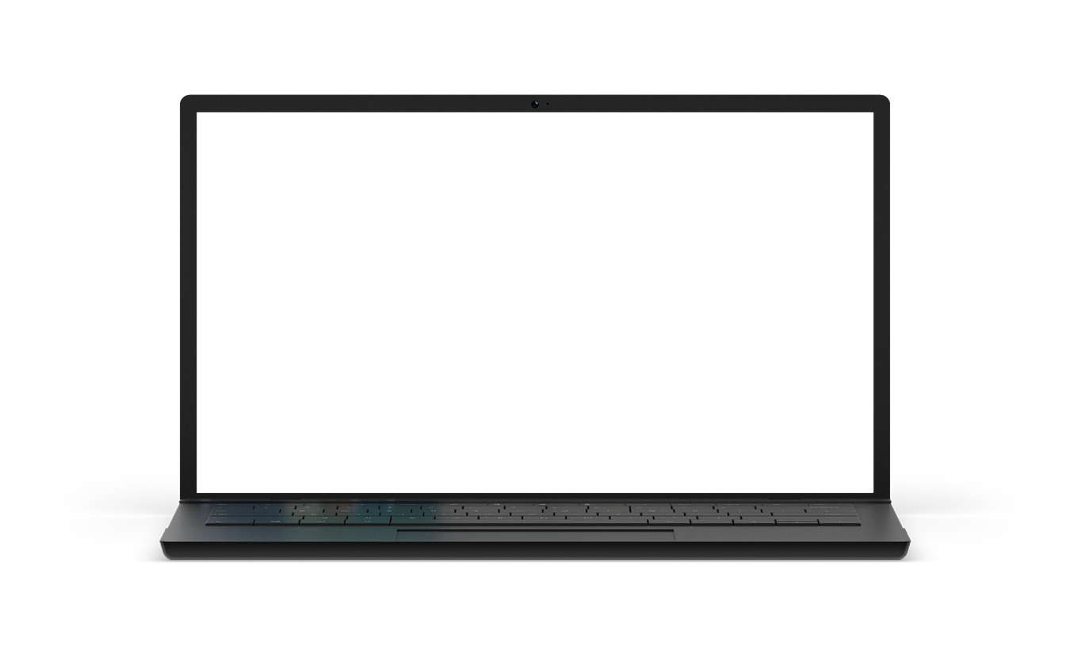
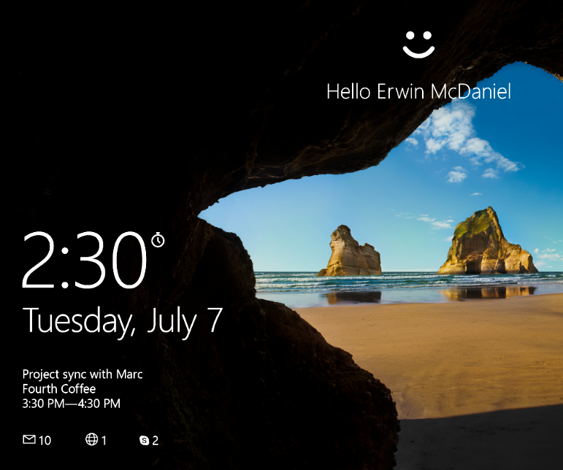

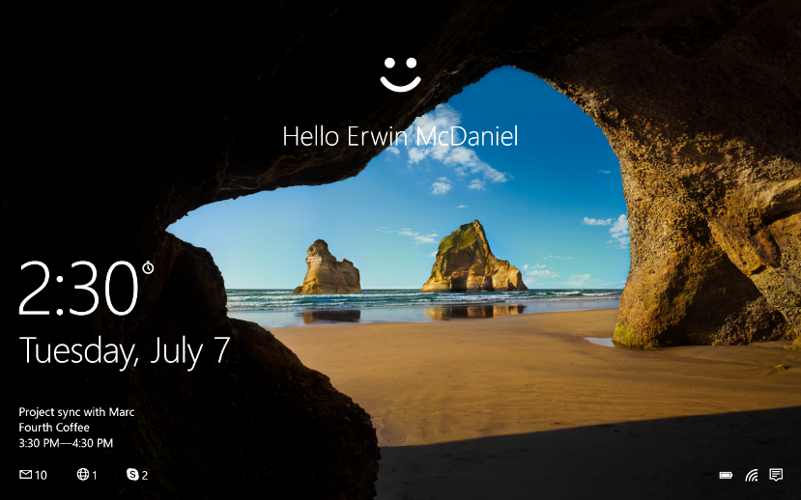

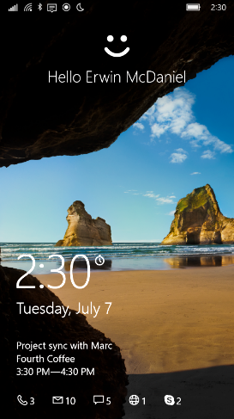
Microsoft Passport & Windows Hello
Convenient multi-factor authentication
Microsoft Passport
Enterprise-grade two-factor authentication
Device + PIN or biometric
Windows Hello
Biometric framework supporting face, iris and fingerprint
Azure AD, on prem AD, and Microsoft Account are already integrated with Microsoft Passport
Notes:
Microsoft Passport: this is the technology which create the multi-factor authentication platform a developer can leverage. It uses public private key pairs for users and their apps, if available protected by the TPM chip. You have to set up a pin in the OS to enable Microsoft Passport. The PIN and access to the physical machine is what makes this more secure than just login name and password. (you cant start guessing the PIN code in your little room at the other side of the world if you don’t have the machine)
The TPM chip can help here in protecting against brute-forcing etc. (Every Windows Phone has a TPM chip for example and more and more PCs and laptops have them as well. If there is no TPM chip we create and protect the keys in software.
Windows Hello is our biometric framework and this can replace the pin for something more convenient like face recognition, fingerprint or iris scan.
So to be very clear Microsoft Passport is what you enable when you set up the PIN in the OS, Windows Hello is replacing that PIN with a biometric gesture.
Enterprise credential protection using Virtual Secure Mode (VSM) Microsoft Passport provides great protection to your users credentials, however you may not be aware that your user’s derived credentials which are used for single sign-in (SSO), may also be under attack. Windows uses hardware-based virtualization to isolate and help protect derived credentials from malware and attackers even if Windows itself has been compromised.

Slide 22
Windows 10 and Microsoft Passport Simple for Developers
Reduces the cost associated with password compromise and reset
UWP API support for strong authentication using Microsoft Passport
JavaScript API support for browsers coming

Slide 23
Windows 10 for Enterprise

Slide 24
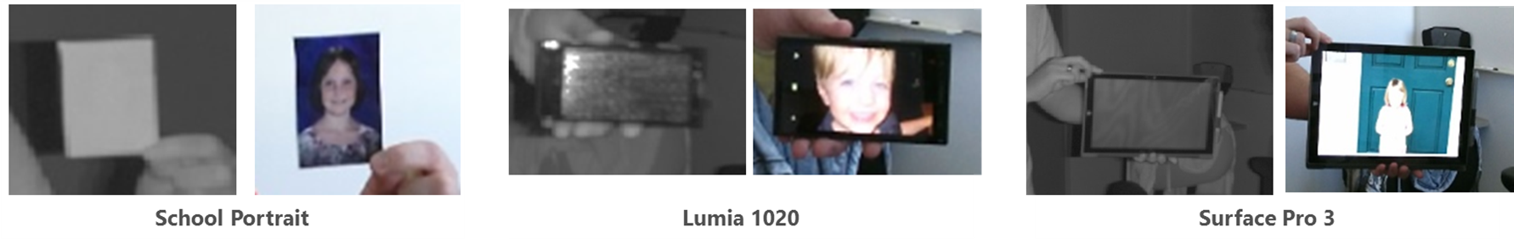
Windows Hello: Enterprise-grade Security
Meets enterprise-grade security:
Demonstrate False Acceptance Rate (FAR): 1/100,000
With False Rejection Rate: 2-4%,
Provide live-ness measures
Enable anti-spoofing detection

Slide 25
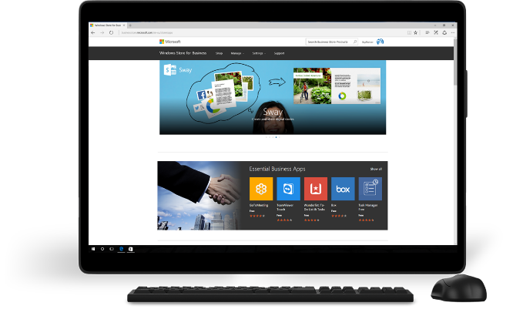
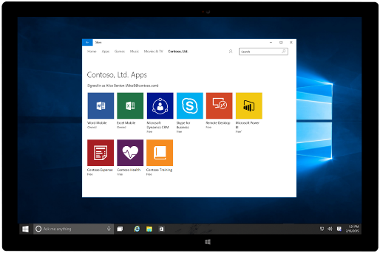
Windows Store for Business Leverage the Windows platform to build and distribute high value business experiences
Extend your reach to organizations in volume
Broaden reach to millions of business and education users
Address high value needs with the right apps
One place, same tools
Submit in familiar Windows Dev Center – same submission flow
Track all apps on dashboard
Available in select markets, payment methods will be added at a later date
Notes:
In fact there are hundreds of millions of users running Windows globally and based on Microsoft internal estimates, small to medium businesses alone spend tens of billions of dollars (USD) annually on desktop software, applications and utilities.
The Windows Store for Business will represent a new opportunity to increase developer reach and revenue possibilities by providing visibility and access to a large installed base of Windows 10 business and education customers across device types – including PCs, tablets and phones – with a single universal app. Business models such as volume distribution will enable developers to make their apps broadly available to organizations of all sizes.
We made it simple. Through a single Dev Center submission process you can make your application available in the consumer as well as the Windows Store for Business. Various payments instruments for organizations will be added over time.

Slide 26
Enterprise Settings Sync via AAD
Settings and application data roaming for Azure Active Directory (AAD) users through the Microsoft Azure cloud
Windows settings, such as Theme, Browser settings, Passwords, Language preferences
Application data that is written to the roaming folder and roaming settings
AAD Roaming operates very similarly to the standard, consumer Microsoft Account (MSA) roaming
Benefits of AAD Roaming compared to MSA Roaming:
Separation of corporate and consumer data
Enhanced security via Azure RMS encryption
Management and monitoring services
Notes:
With Windows 10, Azure Active Directory (AAD) users gain the ability to securely roam their user settings and application data to the Microsoft Azure cloud. Roaming provides users with a synchronized experience across all their Windows devices and reduces the time needed for configuring a new device. AAD Roaming operates very similarly to the standard, consumer Microsoft Account (MSA) roaming that existed in Windows 8.1.
However, AAD Roaming offers a few extra benefits compared to MSA Roaming, including:
* Separation of corporate and consumer data – Organizations are in control of their data, and there is no mixing of corporate data in a consumer cloud.
* Enhanced security via Azure RMS encryption – Data is encrypted before leaving the user’s Windows 10 device, and data stays encrypted at rest in the cloud. Organizations have the ability to manage their own encryption keys with an Azure RMS subscription.
* Management and monitoring services – Available in the Azure Admin portal.
AAD roaming is available to all business users who already have an AAD subscription. Organizations with an O365 subscription already have an AAD subscription.

Slide 27
Windows 10 Build 10586 SDK

Slide 28
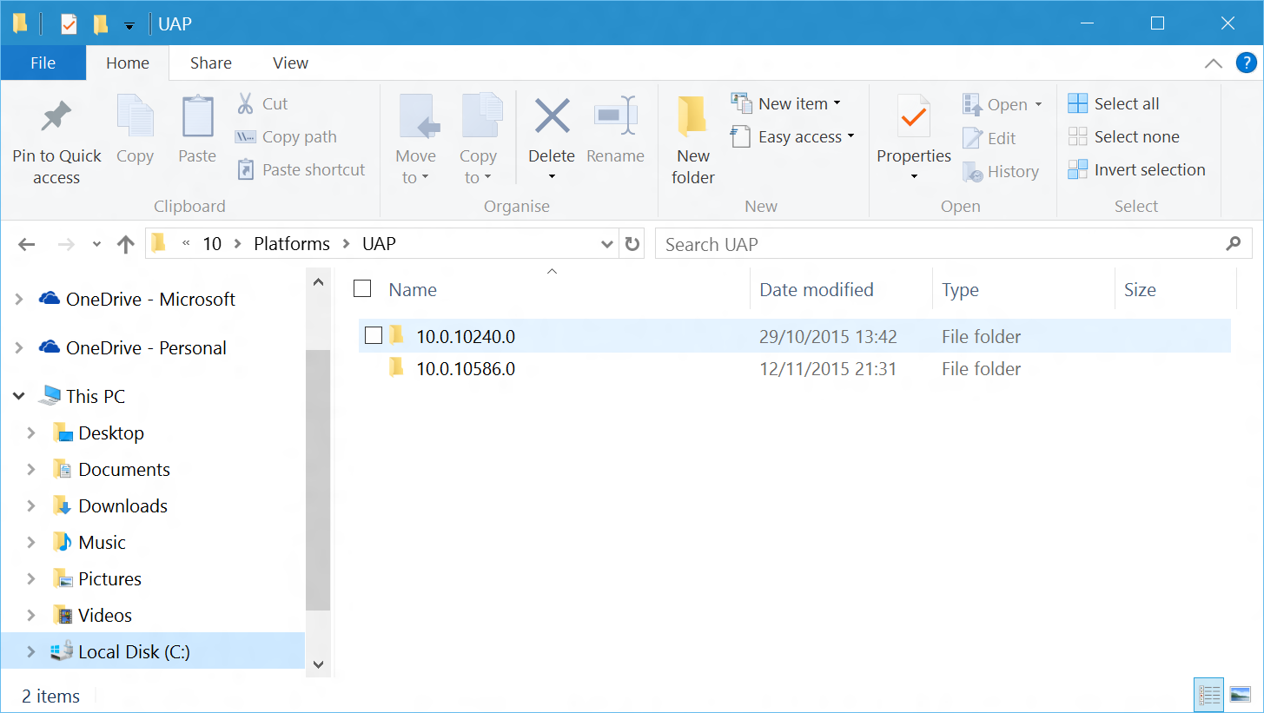
Windows 10 Build 10586 SDK
Installs side-by-side with 10240
C:\Program Files (x86)\Windows Kits\10\Platforms\UAP

Slide 29
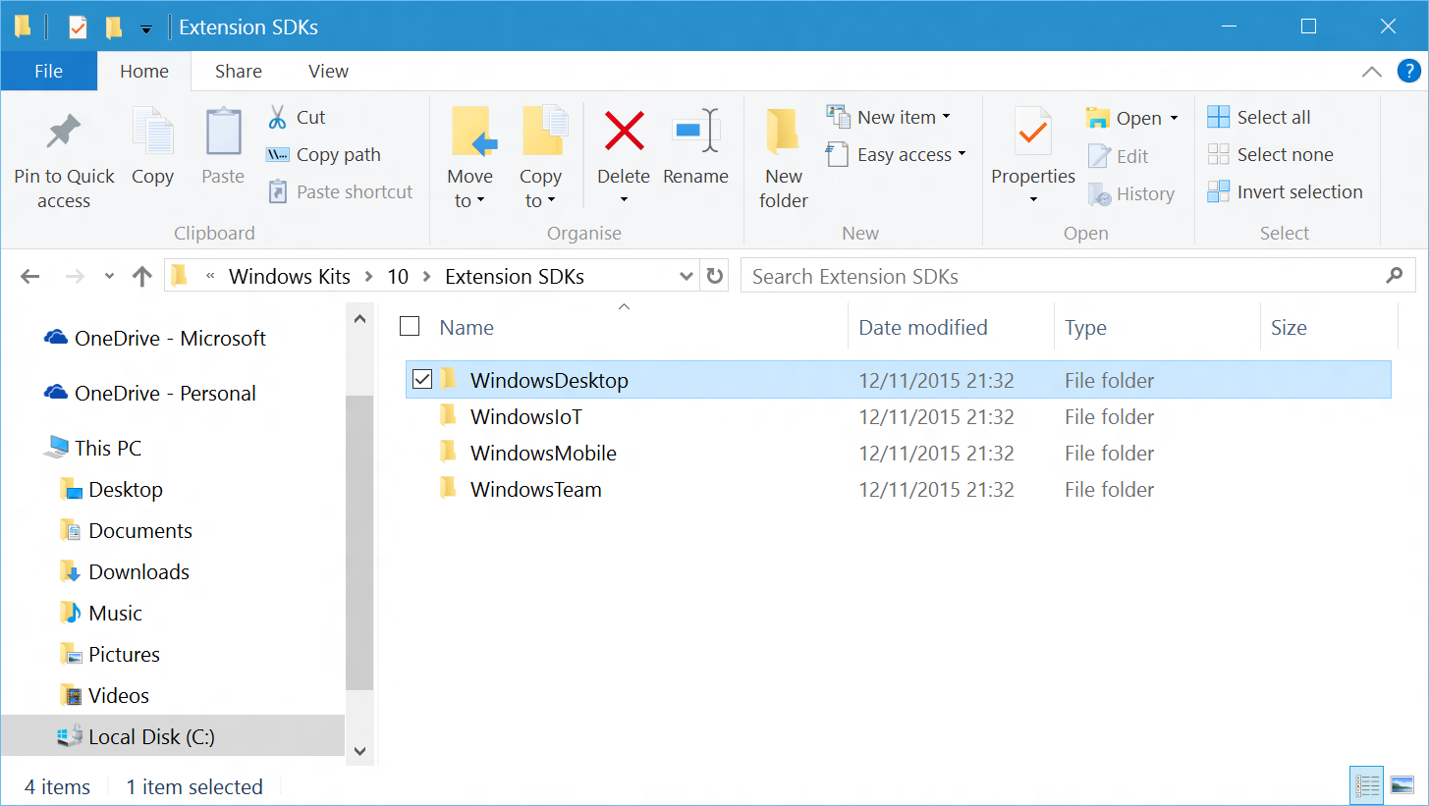
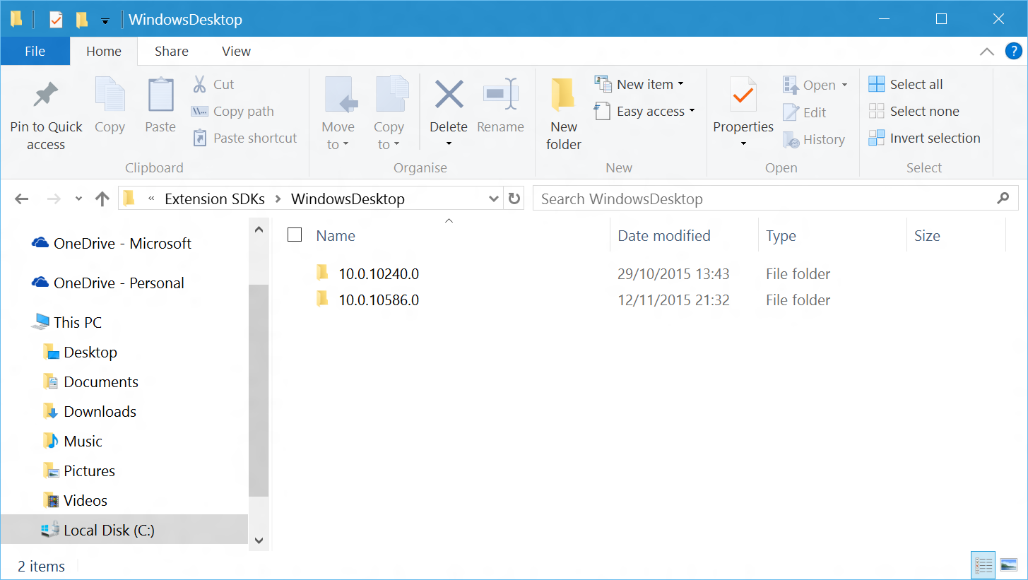
Updates to Extension SDKs
Updates for Desktop, Mobile, IoT and Team extension SDKs
C:\Program Files (x86)\Windows Kits\10\Extension SDKs

Slide 30
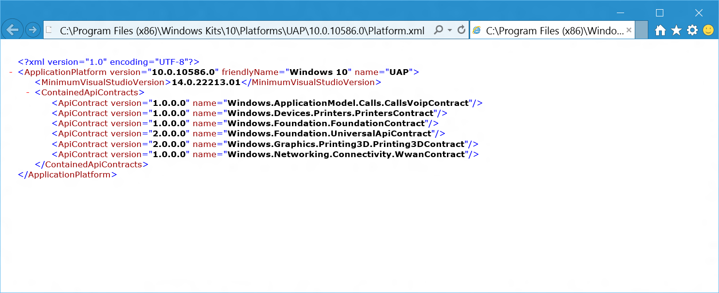
What’s In the 10586 SDK?
Bug fixes to existing UWP APIs
Universal API Contract and Printing 3D Contract move to version 2.0.0.0

Slide 31
New APIs in Universal API 2.0
Over 200 new types or additional methods, properties to existing types
Selection:
Windows.Devices.Bluetooth – new pairing methods in the DeviceInformationPairing class allow pairing / unpairing from within the app with optional protection levels
Windows.Devices.Bluetooth.BluetoothLEAppearance* - new types
Windows.Devices.Bluetooth.Rfcomm.RfcommServiceProvider – new StartAdvertising method
Windows.Devices.Printers.Extensions.Print3DWorkflow* - new types
Windows.Devices.Perception namespace - contains the client APIs that allow a UWP application to access the color, depth, or infrared data of computer vision cameras
Windows.Devices.Sensors – new methods to get readings for Pedometer and ProximitySensor, and new PedometerDataThreshold and ProximitySensorDataThreshold types
Windows.Devices.WiFiDirect – new types and methods to assist WiFiDirect pairing
Windows.Gaming.UI.GameBar
Windows.Graphics.Holographic – many new types, including HolographicCamera, HolographicFrame and HolographicSpace

Slide 32
New APIs in Universal API 2.0 – cont.
Windows.Perception.People.HeadPose
Windows.Perception.Spatial – major new namespace to describe objects positioned in a user’s surroundings
Windows.Security.Authentication.Web.Provider.WebAccountManager – new PullCookiesAsync method
Windows.Storage.DownloadsFolder – new CreateFileForUserAsync and CreateFolderForUserAsync methods
Windows.Storage.KnownFolders – new GetFolderForUserAsync method
Windows.Storage.StorageLibrary – new GetLibraryForUserAsync method
Windows.System.MemoryManager – new TrySetAppMemoryUsageLimit method
Windows.UI.Composition – Composition was in preview in 10240, now updated and full release
Windows.UI.Input.Spatial – major new namespace to recognize spatial gestures for interaction with devices such as HoloLens
Windows.UI.StartScreen.JumpList* – new types provide apps with ability to programmatically select the type of JumpList to use
Windows.UI.Xaml.Controls.Maps – Additions to the Map control, including MapRightTapped support
Windows.Web.Http.Filters.HttpBaseProtocolFilter – new CookieUsagebehavior property allows developers to have control of how cookies are handled by the system.

Slide 33
Demo: 10586 SDK Samples

Slide 34
Which SDK should I target?

Slide 35



When will 1511 reach end-user devices?
Consumer devices
Business users
Specialized systems
Updates installed via Windows Update as they arrive
Keeping hundreds of millions of consumers up to date and secure on the Current Branch
Large and diverse user base helps drive quality of the OS updates
BYOD devices are up to date & secure
Update their devices after features are validated in the market
Current Branch for business
Windows Update for Business
Examples: Air Traffic Control, Emergency Rooms
No new functionality on Long Term Servicing Branch
Regular security updates
Control with WSUS
Notes:
With Windows 10, we are introducing a new way of keeping consumers up to date and secure, delivering new builds of Windows as they arrive. BYOD devices will also benefit from this, keeping them up to date and secure.
For business critical systems, we are introducing the Long Term Servicing Branch (LTSB), allowing customers to stay on the current Windows build to ensure security and consistency of the devices on this update cadence. The Universal Windows Platform is supported on all of these update branches, but UWP apps will need to take into consideration the characteristics of the build they will be run on (e.g. keeping apps secure, but feature stable for LTSB).
Business customers will continue to be able to deploy Windows 10 via existing management tools (such as WSUS and SCCM) and in addition, we introduced Windows Update for Business that can be used to stay up to date with Windows (Current Branch and Current Branch for Business).

Slide 36


UWP Versioning in Project Properties

Slide 37
Dependencies in AppxManifest.xml
By default, Project properties versions sets dependencies declared in Appxmanifest.xml
AppxManifest.xml is the built version of Package.appxmanifest
Created during project build – in /bin/debug or /bin/release
Project Targeting Properties ➔ Appmanifest.xml
<Dependencies>
<TargetDeviceFamily
Name="Windows.Universal"
MinVersion="10.0.10240.0"
MaxVersionTested="10.10586.0.0"/>
</Dependencies>
Notes:
In your application’s Package Manifest, you will have a declaration such as this.
What this says is that this app was built against UWP version 10.0.10240.0 (the first version that went on GA - General Availability). When you create your first UWP apps, the MaxVersionTested will also be set to 10.0.10240.0, but imagine a time in the future, when newer versions of the UWP have been released to install side by side with earlier versions.
If you the developer have tested this app on UWP version 10.5.0.0, you can declare this in the manifest. What this then says is that this app package will run just great on 10.5.0.0. It doesn’t mean it cannot run on later versions, just that if it does, then the runtime should enforce version 10.5.0.0 behaviors.
The Windows Store uses this information to ensure the best available version of an app package gets deployed to target machines.

Slide 38
Demo: UWP SDK Targeting

Slide 39
Versioning determines where app can run
<Dependencies>
<TargetDeviceFamily Name="Windows.Universal" MinVersion="10.0.10240.0" MaxVersionTested="10.10586.0.0"/>
</Dependencies>
Runs on 10240 or higher. On > 10586, quirked to 10586 behavior.
Optionally, code may call APIs from 10586 SDK when running on 10586 or higher machines.
<Dependencies>
<TargetDeviceFamily Name="Windows.Universal" MinVersion="10.0.10586.0" MaxVersionTested="10.10586.0.0"/>
</Dependencies>
Runs on 10586 or higher. On > 10586, quirked to 10586 behavior.
Cannot run on 10240 machines
Code may call any APIs from the 10586 SDK

Slide 40
If your app package will run on multiple versions, and you use APIs from a later SDK version than your MinVersion, you must gate calls using API feature detection

Slide 41
Test capabilities at runtime
Use feature detection (i.e. Adaptive Code) to light-up your app with new APIs if you still want your package to run on down-level devices
var api = "Windows.Graphics.Display.DisplayInformation.DiagonalSizeInInches";
if (Windows.Foundation.Metadata.ApiInformation.IsTypePresent(api))
{
var diagSz = Windows.Graphics.Display.DisplayInformation.GetForCurrentView().DiagonalSizeInInches;
}
Notes:
So, we’ve got these device family-specific APIs that your app code can use, but they are only usable at runtime on specific device families. How do we make sure these APIs are called only at the appropriate time?
The answer is to ‘gate’ calls to any API in an extension SDK with runtime checks to verify that a particular API is available to use. You do this using methods of the Windows.Foundation.Metadata.ApiInformation API. The most common method to use is IsTypePresent() which is a runtime check that the named API is actually loaded and usable wherever the app happens to be running.

Slide 42


PlatformSpecific.Analyzer NuGet package

Slide 43
Demo: Using Feature Detection

Slide 44
Advanced Versioning

Slide 45
Dependencies in AppxManifest.xml
By default, Project properties versions sets dependencies declared in Appxmanifest.xml - But only if your Package.Appxmanifest declares a TargetDeviceFamily dependency on Windows.Universal
Created during project build – in /bin/debug or /bin/release
AppxManifest.xml is the built version of Package.appxmanifest
Package.Appxmanifest ➔ Appmanifest.xml
<Dependencies>
<TargetDeviceFamily
Name="Windows.Universal"
MinVersion="10.0.0.0"
MaxVersionTested="10.0.0.0"/>
</Dependencies>
<Dependencies>
<TargetDeviceFamily
Name="Windows.Universal"
MinVersion="10.0.10240.0"
MaxVersionTested="10.10586.0.0"/>
</Dependencies>
Notes:
In your application’s Package Manifest, you will have a declaration such as this.
What this says is that this app was built against UWP version 10.0.10240.0 (the first version that went on GA - General Availability). When you create your first UWP apps, the MaxVersionTested will also be set to 10.0.10240.0, but imagine a time in the future, when newer versions of the UWP have been released to install side by side with earlier versions.
If you the developer have tested this app on UWP version 10.5.0.0, you can declare this in the manifest. What this then says is that this app package will run just great on 10.5.0.0. It doesn’t mean it cannot run on later versions, just that if it does, then the runtime should enforce version 10.5.0.0 behaviors.
The Windows Store uses this information to ensure the best available version of an app package gets deployed to target machines.

Slide 46
Can restrict target device families
<Dependencies>
<TargetDeviceFamily Name="Windows.Universal" MinVersion="10.0.10240.0" MaxVersionTested="10.10586.0.0"/>
<TargetDeviceFamily Name="Windows.Desktop" MinVersion="10.0.10586.0" MaxVersionTested="10.10586.0.0"/>
</Dependencies>
Runs on 10240 or higher on any Windows 10 device
Apart from on Desktop device family, where this package may run on 10586 or higher, but not on 10240
<Dependencies>
<TargetDeviceFamily Name="Windows.Mobile" MinVersion="10.0.10586.0" MaxVersionTested="10.10586.0.0"/>
</Dependencies>
Runs only on Windows Mobile device family, version 10586 or higher.
Cannot run on other Windows 10 devices, nor on Windows Mobile version 10240 machines.

Slide 47
Visual Studio 2015 Update 1

Slide 48


XAML Behaviors platform now in NuGet
XAML Behaviors is an easy-to-use means of adding common and reusable interactivity to your Windows UWP applications with minimal code
Behaviors are now open sourced and on github: https://github.com/Microsoft/XamlBehaviors

Slide 49

XAML Designer: Disable project code
XAML designer failures can be caused by project code
Can prevent them by disabling project code in the designer
Project code includes:
Custom controls and user controls
Class libraries
Value converters
Bindings against design time data generated from project code
See Debugging or Disabling Project Code in XAML Designer
https://msdn.microsoft.com/en-us/library/mt622752.aspx

Slide 50

Go to Implementation
Right-click on an interface or abstract method definition and navigate to its implementation

Slide 51

C# Interactive Window is back!
C# REPL command-line window
csi.exe - run a C# script file (.csx) from the Developer Command Prompt
Notes:
The C# Interactive Window is back in Visual Studio, as well as the command-line C# REPL window. (The Interactive Window is the REPL window inside Visual Studio.)
We've also released scripting APIs that enable you to build and run C# as a script. The scripting APIs are available on GitHub.
Additionally, we've released csi.exe, which is a tool that you can use to run a C# script file (.csx) from the Developer Command Prompt. For example, simply type csi myScript.csx to run your script file. Or, you can enter the command-line REPL mode to interactively evaluate snippets of C# code. To get to this mode, run the command csi without any arguments from the Developer Command Prompt.

Slide 52

.NET Native Shared Assembly Framework
Opt-in feature to reduce Release mode app size
For most apps, reduces Release mode build time
<UseDotNetNativeToolchain>true</UseDotNetNativeToolchain>
<UseDotNetNativeSharedAssemblyFrameworkPackage>true
</UseDotNetNativeSharedAssemblyFrameworkPackage>
Read more: http://blogs.msdn.com/b/dotnet/archive/2015/10/20/10644260.aspx
Notes:
Actually released in the Win Tools 1.1 update:
How the feature works. When the feature is enabled, .NET Native release builds no longer include the bulk of .NET locally within the app. Instead .NET is delivered through a "Shared AppX Framework Package". That means:
1.When customers download your app from the Store, this download doesn't contain the bulk of .NET
2.Instead, the right version of .NET gets automatically downloaded on-demand from the Store, and is shared between all apps that use it.
You can see how it's accomplished inside your app's bin\Release\x86\ilc\AppxManifest.xml file. It has a line like this, which is what the Store app obeys when installing your app:
<PackageDependency Name="Microsoft.NET.Native.Framework.1.2"
MinVersion="1.2.23231.0" />
You must opt-in by a configuration flag as follows. Within Visual Studio, right-click on your UWP project and unload project. Right-click once again and Edit the .vbproj/.csproj. Within this proj file, look for all three occurrences of <UseDotNetNativeToolchain> and add a new directive under them as shown above. By default, the three places that use the .NET Native toolchain are Release|x86, Release|x64 and Release|Arm.

Slide 53
Getting the developer tools

Slide 54
Visual Studio 2015 Editions
Enterprise
The most comprehensive edition of Visual Studio offering enterprise grade capabilities for projects of all complexities.
Professional
Ideal for individuals or small teams that want all the benefits of building apps with advance features.
Community Editions
A free, full-featured and extensible tool for developer non-enterprise apps
New downloads have Update 1 integrated
Existing installations can update through Tools- Extensions and Updates, or download from http://go.microsoft.com/fwlink/?LinkId=691129
Notes:
Visual Studio 2015 comes in a number of editions that serve the needs of different groups of developers.
Visual Studio Enterprise with MSDN is an Enterprise grade solution with advanced capabilities for teams working on projects of any size or complexity, including advanced testing and DevOps.
Visual Studio Professional with MSDN offers professional developer tools and services for individual developers or small teams.
Visual Studio Community is a free, full-featured and extensible tool for developers building non-enterprise applications.

Slide 55

Where can I develop?
Windows 10
Requires Visual Studio 2015
Note that XAML designer in projects targeting 10586 requires that Windows 10 has been updated to 1511
Windows 8.1 & Windows Server 2012 R2
The Visual Studio XAML designer does not function
Debugging requires a Windows 10 device and Remote Debugging Tools
Notes:
Where can you do development?
Visual Studio 2015 and the Tools for Windows 10 can run on PCs running Windows 10, on PCs running Windows 8.1 and on Windows Server 2012 R2.
To get the best developer experience including full availability of tooling features such as the visual designer, you should use a machine running Windows 10.

Slide 56

New! Windows 10 dev environment 60 day eval
https://dev.windows.com/en-us/downloads/virtual-machines
Notes:
If you are interested in developing for Windows 10 and want to test out the Windows Bridge for iOS or IoT development or just UWP development in general, we are releasing 60 day evaluation developer virtual machines (VM) on Windows Dev Center. These VMs will have the latest snapshots of the develop tools for Azure and Windows IoT Core as well. Additionally, the VMs contain the Windows UWP samples from Github. These VMs will be releases in multiple virtual hard disc formats as well: Hyper-V, Parallels, VirtualBox, and VMWare.

Slide 57

Windows Bridge for iOS
https://dev.windows.com/en-us/bridges/ios

Slide 58

Bridge for Silverlight Windows Phone 8.1 Apps
Free Visual Studio add-in that accelerates bringing Windows Phone 8.1 apps to UWP
Download: http://www.mobilize.net/download-silverlight-bridge

Slide 59

dev.windows.com
Notes:
Finally, for any questions on how to build apps for Windows 10, and for access to the Dev Center, or to take part in the forums, go to our home on the web: dev.windows.com.
Here you will find tutorials, samples, getting started guides and access to the full documentation.
Everything you need to help you create great UWP apps for Windows 10!

